Slide 1
Asynchronous FIFO

Slide 2
Design specification
I/O defined
From 1 to 127 buffer size. Configurable with BUFFER_SIZE parameter
Area effective
Power effective
Fast

Slide 3
Alternative approaches
Binary pointers passed directly
Bad practice
Binary pointers with REQ/ACK handshaking signals
Safe and simple
Supports any fifo depth, and arbitrary pointer changes
Easy full/empty/almost_full/almost_empty generation
Smaller(2FF per pointer bits + 4 for REQ/ACK)
Higher latency(REQ/ACK signaling)
Possible all pointer bits change per increment
Gray code pointers passed directly
Proven design
Requires power-of-2 fifo depth(most dual-port ram is power-of-2 words deep)
Tricky full/empty /almost_full/almost_empty generation
Larger(4FF per pointer bits)
Lower latency(better performance if full/empty conditions happen often)
Maximum of 1 pointer bit value change per increment

Slide 4
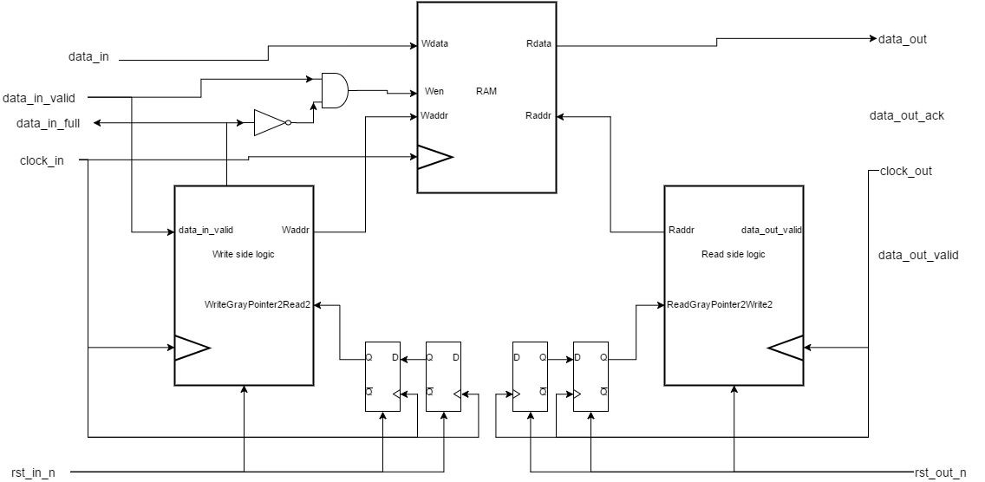
My implementation:

Slide 6
Z

Slide 7
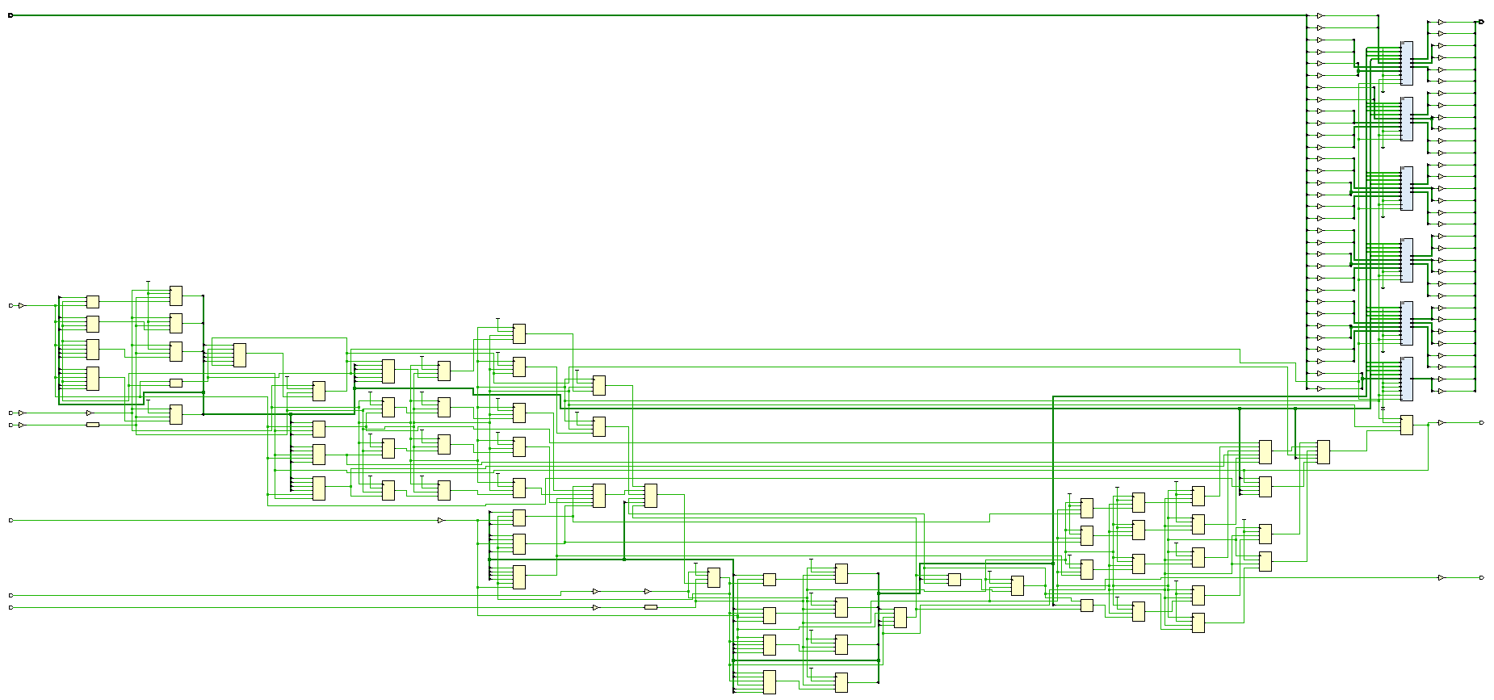
16 (RAM32M)

Slide 8
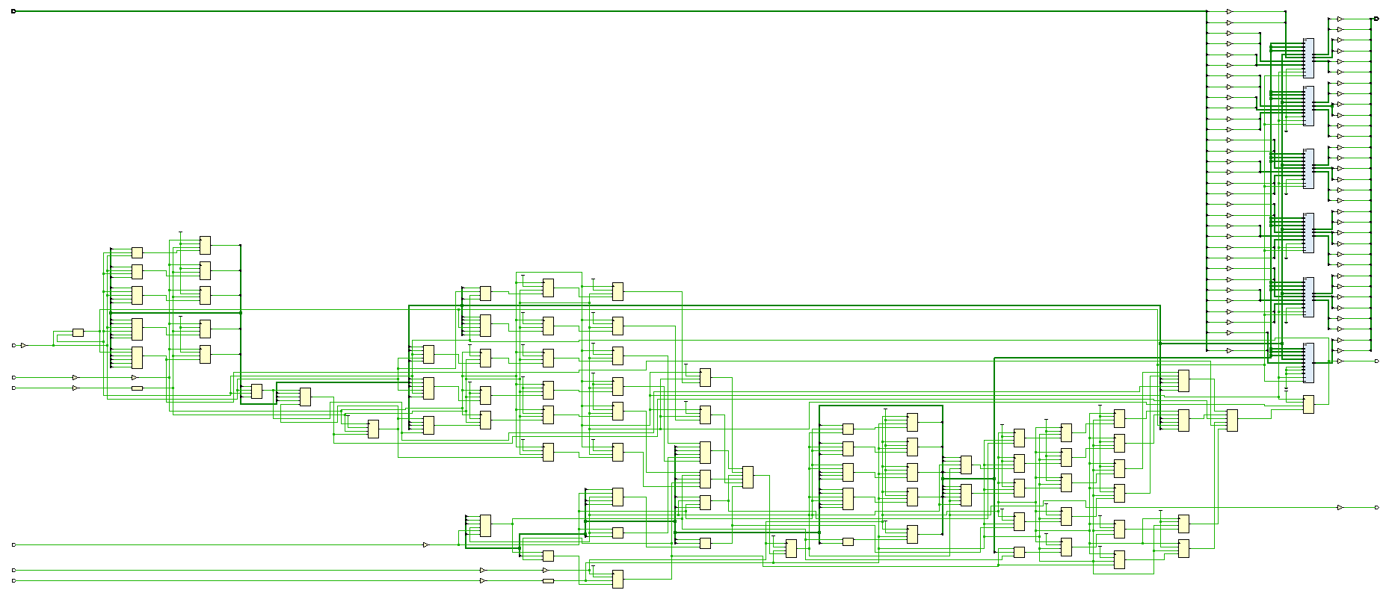
32

Slide 9
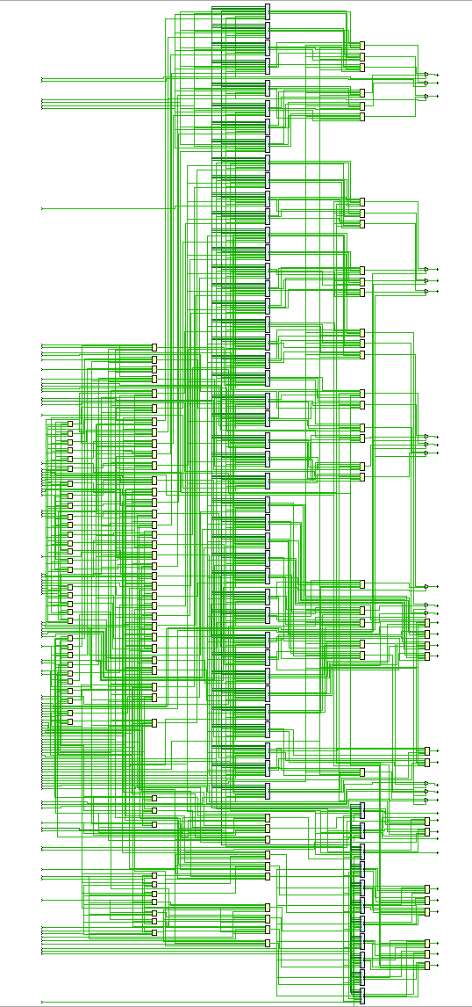
65536

Slide 10
Critical path BUFFER_SIZE 8

Slide 11
Critical path BUFFER_SIZE 128

Slide 12
RTL Analysis

Slide 13
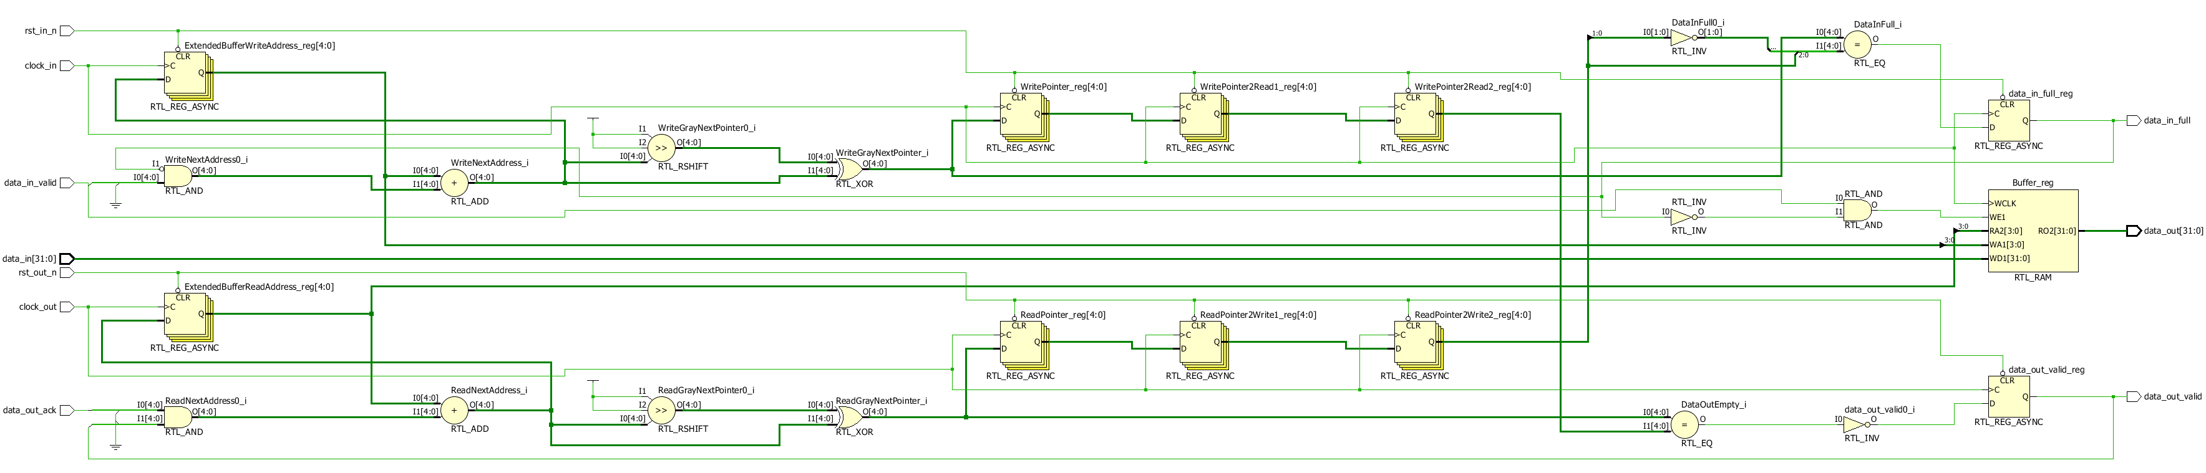

Slide 14
GRAY MSBs show octant/quartant

